Slide 1
WingTipTickets
Azure SQL Database & Azure Search HOL V2.1

Slide 2
Hands-on-lab intro
What you need
A paid Azure account, either your own or using an Azure Pass from us
One of the VMs with the client tools RDP instructions https://www.yammer.com/azureadvisors/#/groups/6200653/files
Instructions and files for the HOL https://github.com/guyhay/WingTipTickets
Tasks to-do this morning
Ensure that you can login to http://portal.azure.com
Ensure that you can connect to the VM
Start the provisioning process for the HOL C:\WingTipTickets

Slide 3
Azure demo
http://portal.azure.com
Azure SQL Database create DB
Connect from SSMS

Slide 4
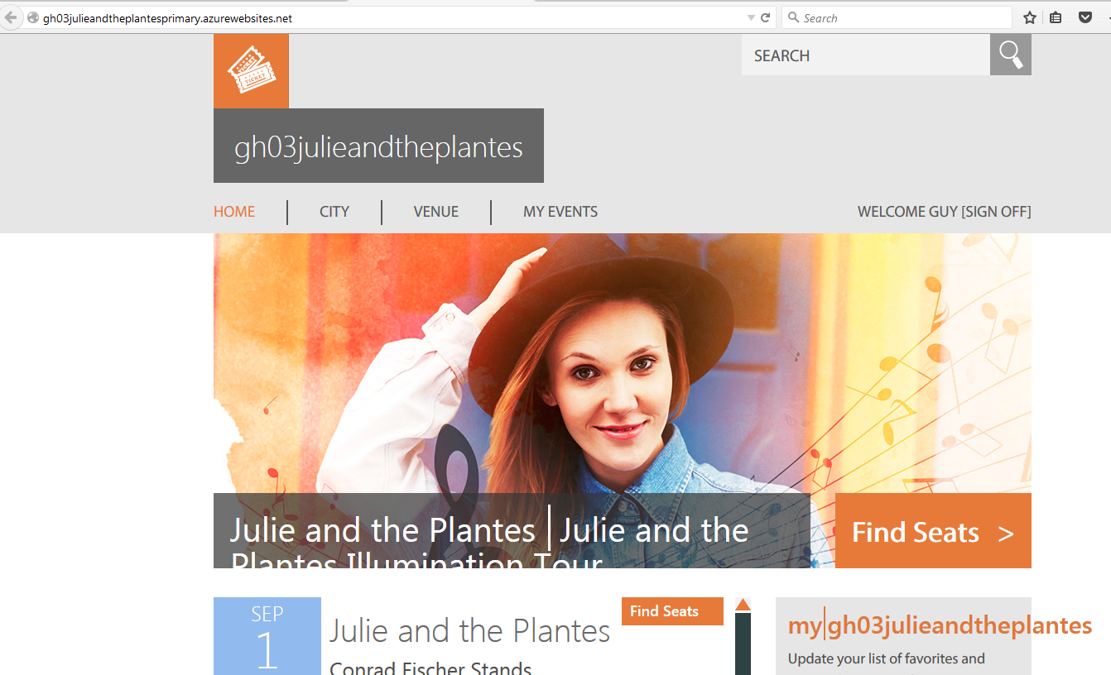

Slide 5
WTT Architecture in your subscription
Region A
Traffic Manager
Region A
Primary
Azure WebApp
Primary Customer Database
Tables:
Concerts
Customers
Tickets
Venues etc
Geographic Replication
Region A
Secondary
Azure WebApp
Secondary Customer Database
Tables:
Concerts
Customers
Tickets
Venues etc
Region B optional

Slide 6
Azure SQL DB demo
Delete DB
Restore DB
Load Generator

Slide 7
HOL Setup Steps
Connect to your VM and navigate to C:\WingTipTickets
Launch Azure PowerShell (as an administrator)
Add-AzureAccount
Optional - Select-AzureSubscription –SubscriptionId <provide your subscription that you want to use>
Set-ExecutionPolicy -Scope LocalMachine -ExecutionPolicy Unrestricted –Force
Switch to the directory C:\WingTipTickets\scripts
Unblock-file .\New-WTTEnvironment.ps1
. .\New-WTTEnvironment.ps1
New-WTTEnvironment -WTTEnvironmentApplicationName xx00julieandtheplantes

Slide 8
Add-AzureAccount
Select-AzureSubscription –SubscriptionId ba047a9f-de49-4f4d-80fd-b21baf9aa67aSet-ExecutionPolicy -Scope LocalMachine -ExecutionPolicy Unrestricted –Force
cd c:\WingTipTickets\Scripts
Unblock-file .\New-WTTEnvironment.ps1
. .\New-WTTEnvironment.ps1New-WTTEnvironment -WTTEnvironmentApplicationName guyjulieandtheplantes

